Slide 1

Урок вот-вот начнется.
Приготовься, сейчас будет что-то новенькое!

Slide 2


Jenkins
Pipelines

Slide 3

Jenkins Pipeline

Slide 4

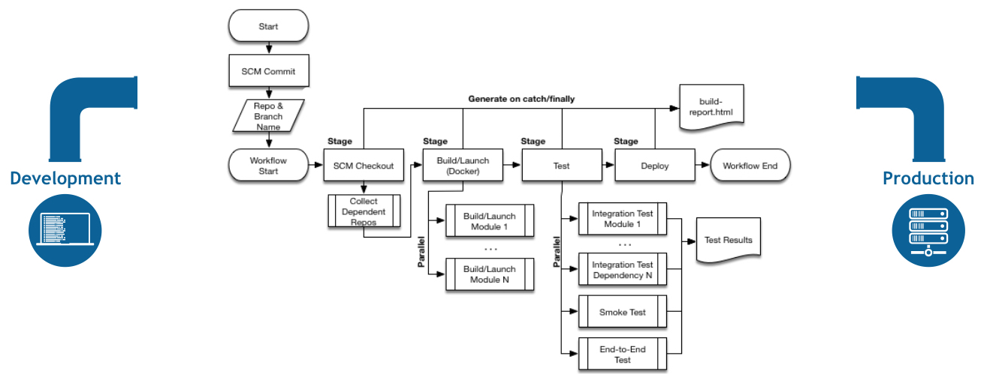
Jenkins Pipeline

Slide 5
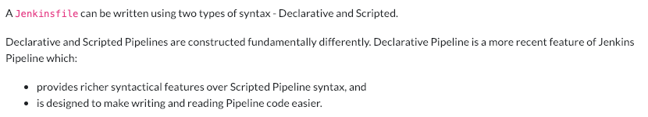
Jenkins Pipeline

Slide 6
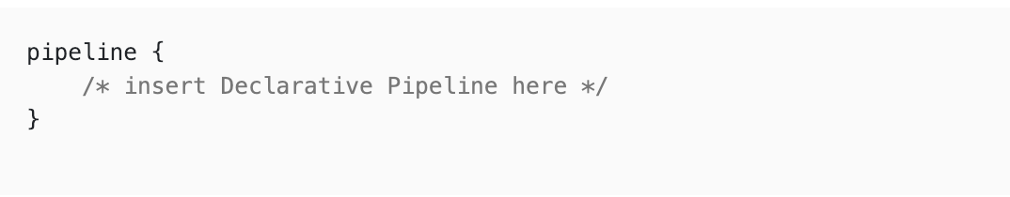
Declarative Pipeline

Slide 7
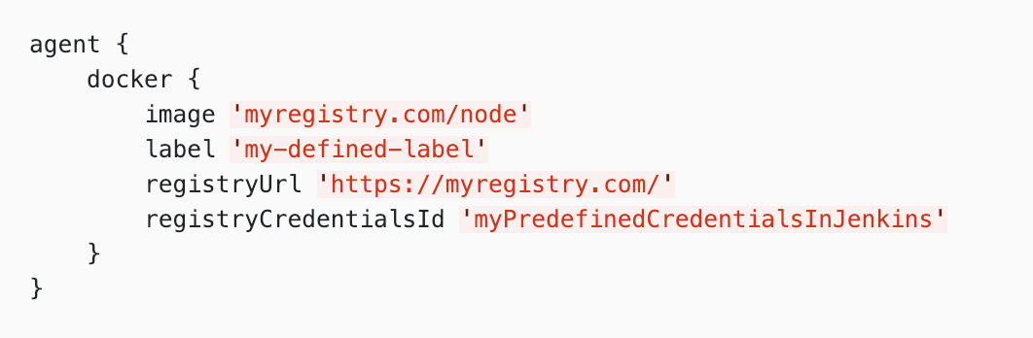
Declarative Pipeline

Slide 8
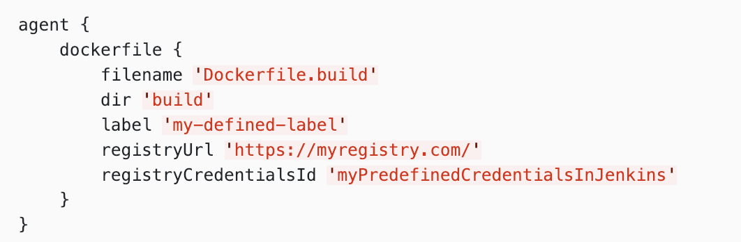
Declarative Pipeline

Slide 9
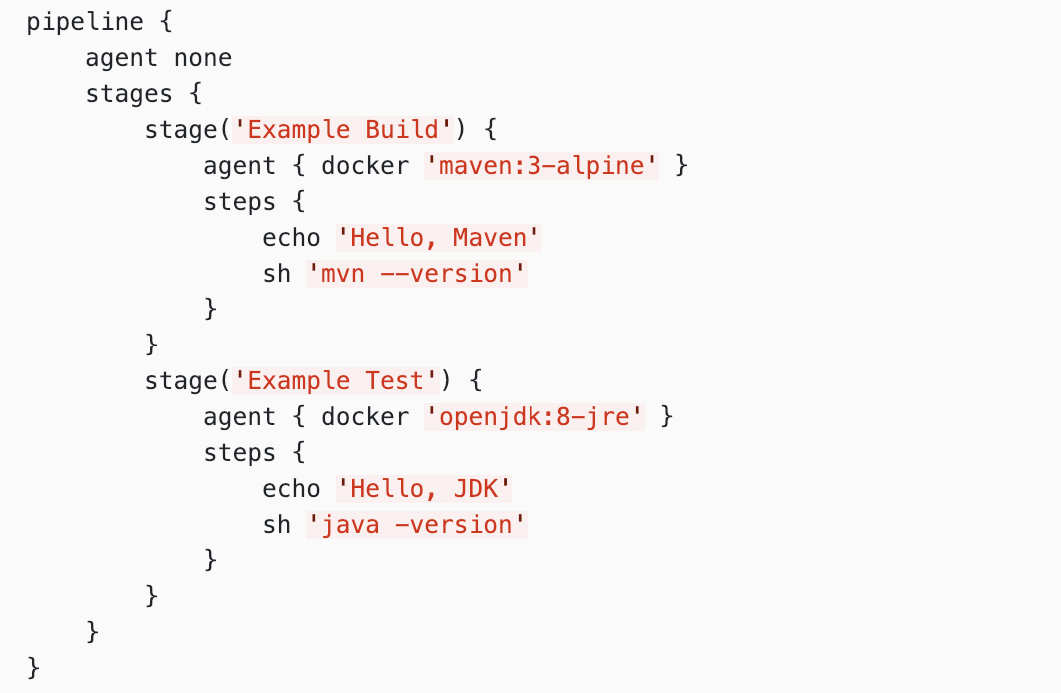
Declarative Pipeline

Slide 10
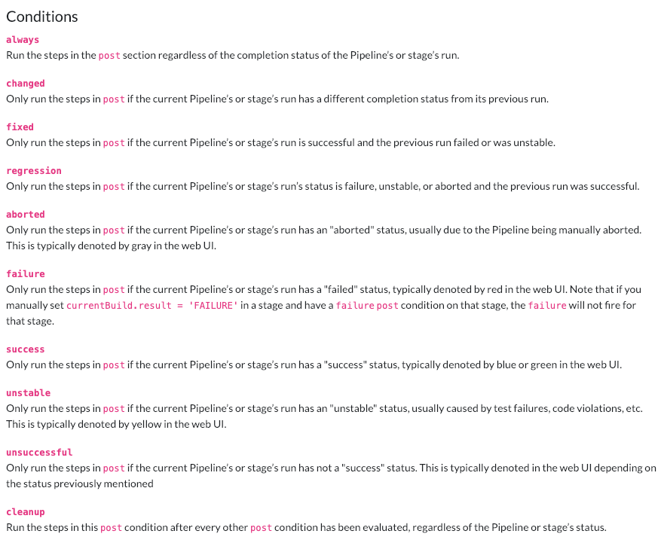

Slide 11
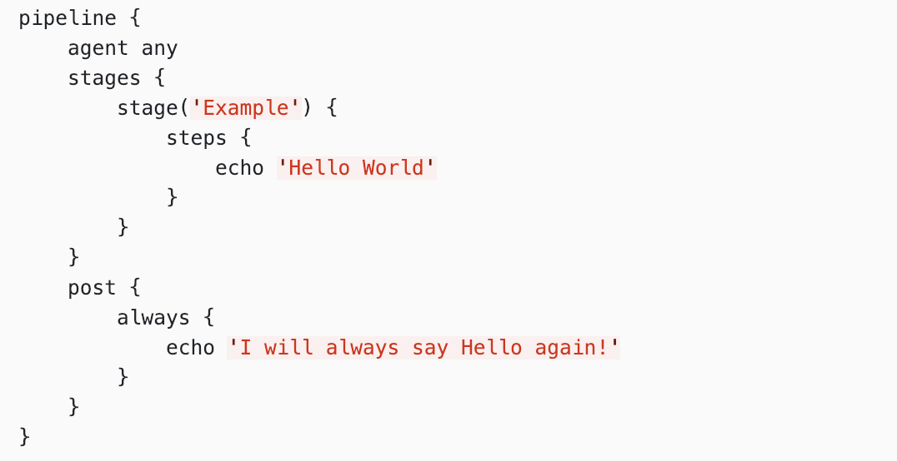
Declarative Pipeline

Slide 12
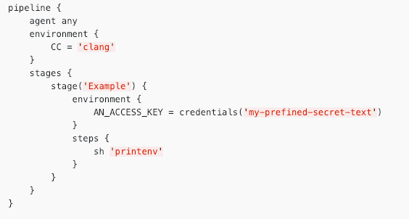
Declarative Pipeline

Slide 13
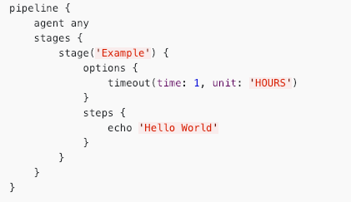
Declarative Pipeline

Slide 14
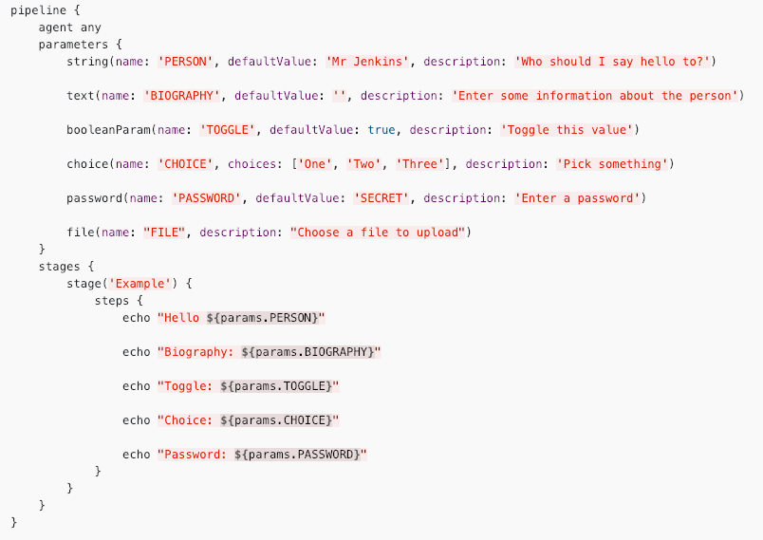
Declarative Pipeline

Slide 15
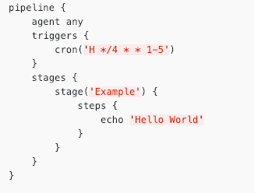
Declarative Pipeline

Slide 16
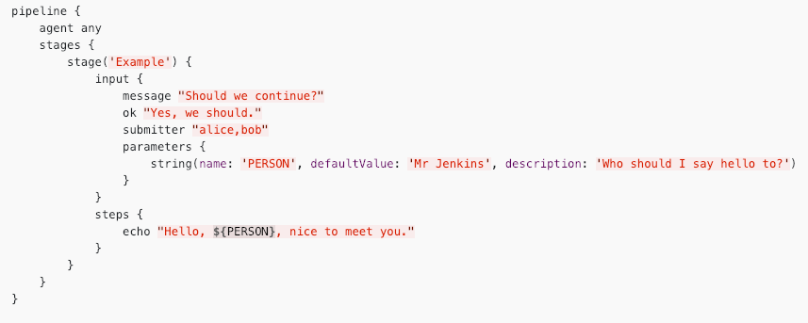
Declarative Pipeline

Slide 17
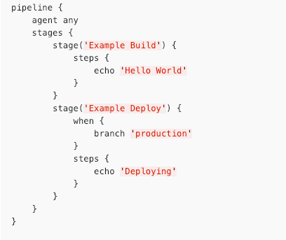
Declarative Pipeline

Slide 18
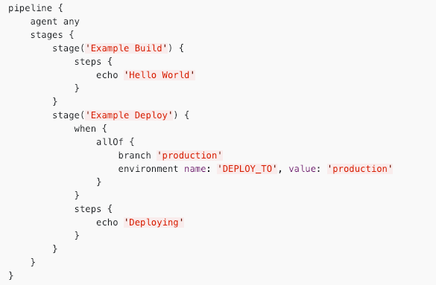
Declarative Pipeline

Slide 19
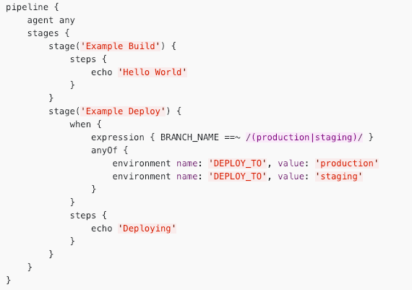
Declarative Pipeline

Slide 20
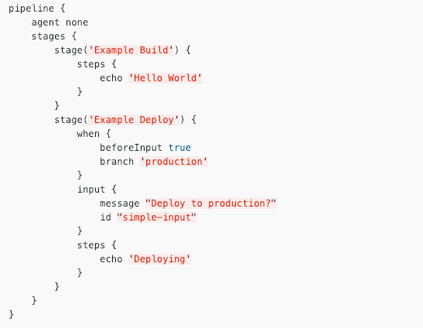
Declarative Pipeline

Slide 21
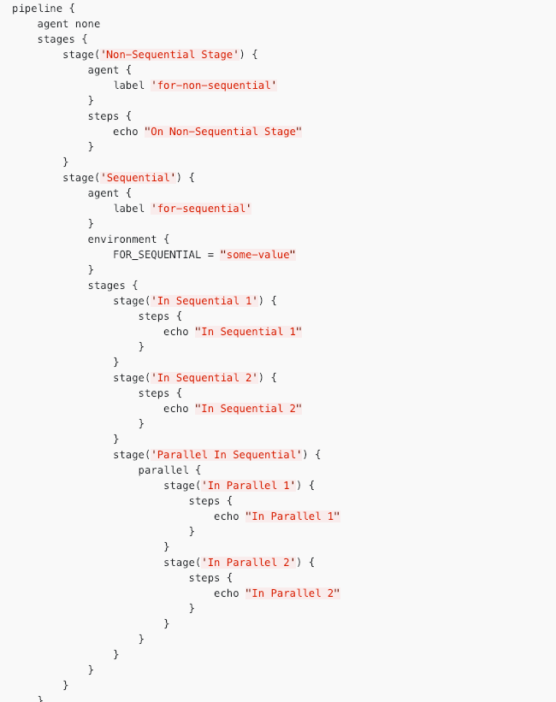

Slide 22
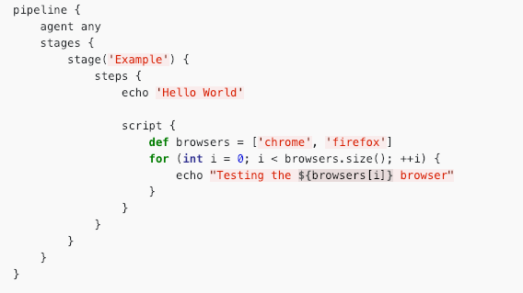
Declarative Pipeline

Slide 23
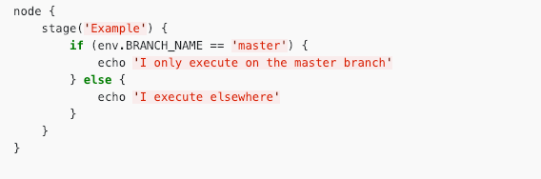
Scripted Pipeline

Slide 24

Shared Libraries

Slide 25
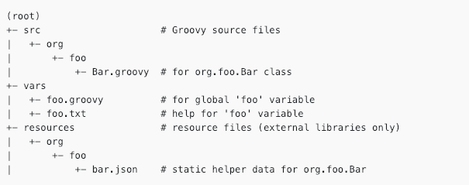
Shared Library Repository

Slide 26
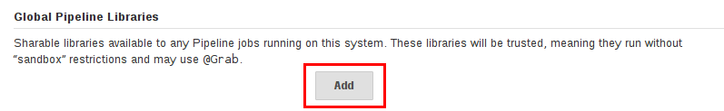
Global Shared Libraries

Slide 27
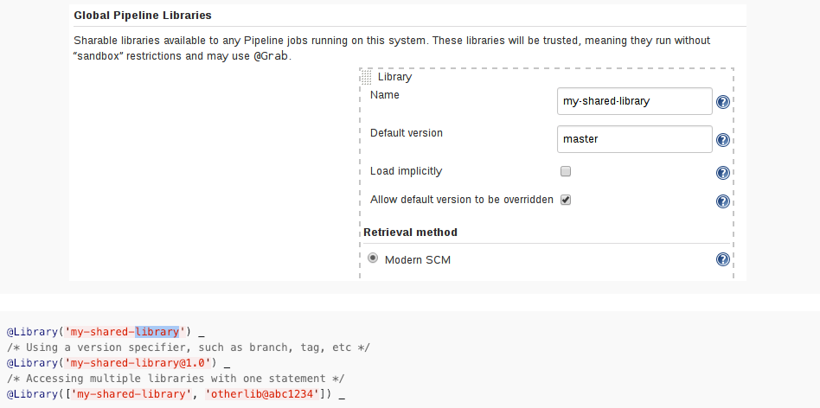
Using Libraries

Slide 28
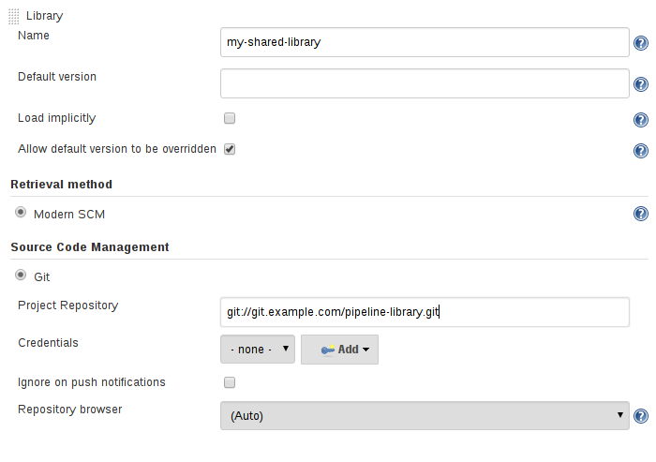
Library versions

Slide 29
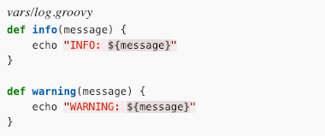
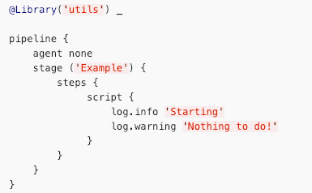
Library in action

Slide 30
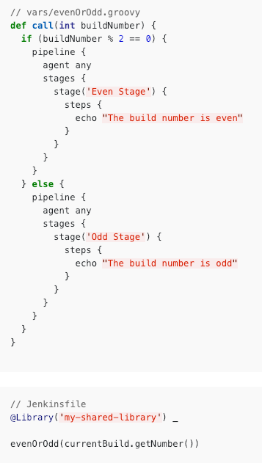
Library pipelines

Slide 31


Questions ?

Slide 32

Thanks for attention!

